Slide 1
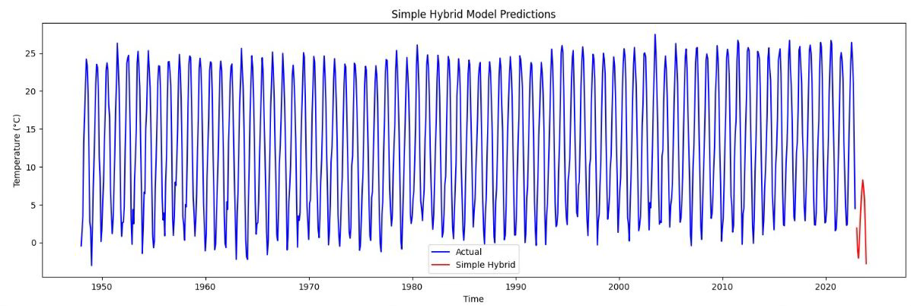
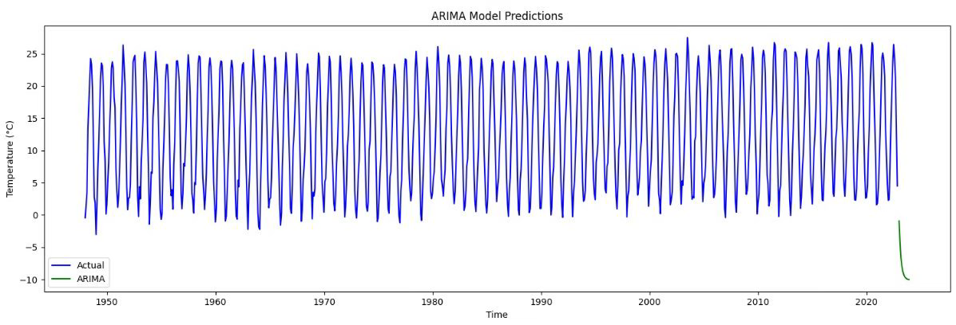
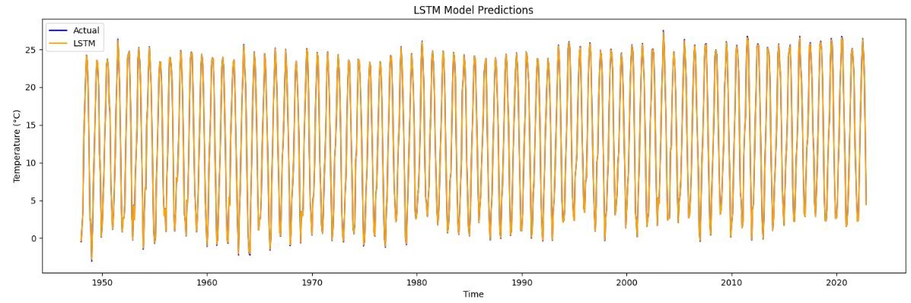
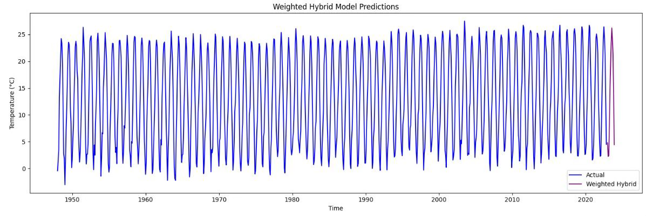
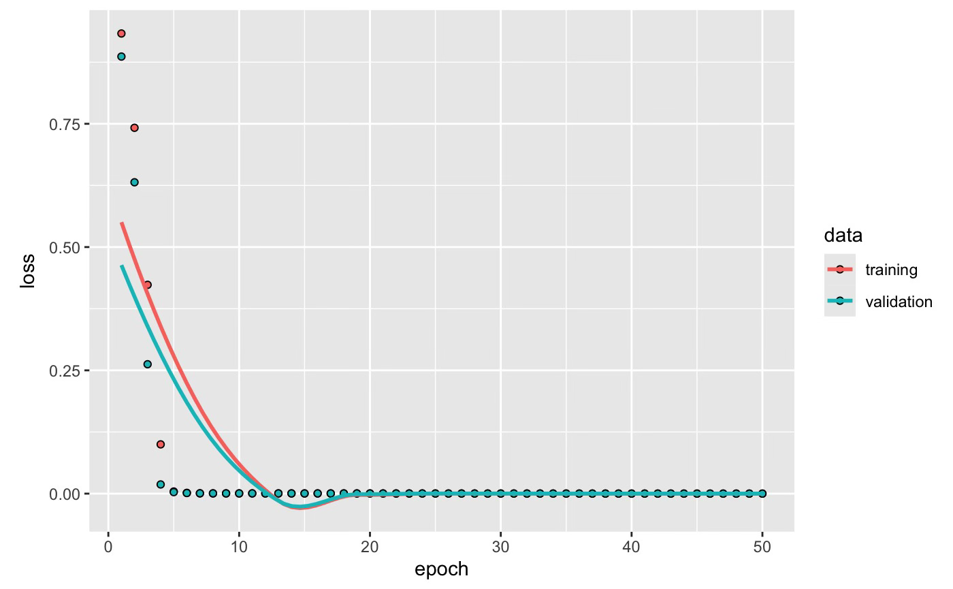
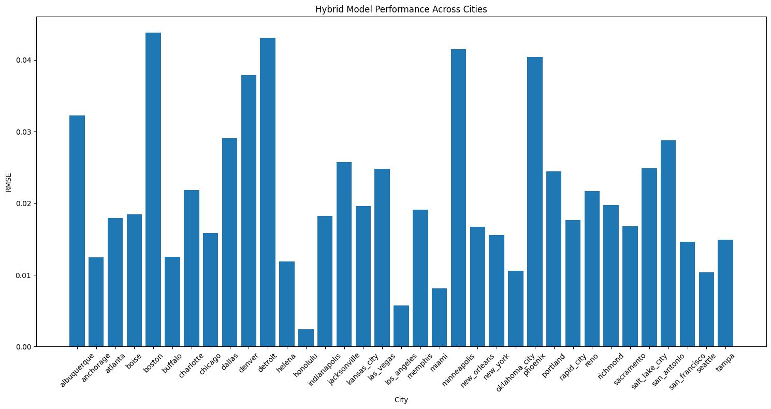
SHORT-TERM TEMPERATURE FORECASTING USING ARIMA-LSTM HYBRID MODELS.
Introduction
The purpose of this project is to address an expanding desire for precise weather forecasts in fields such as agriculture, energy, and transportation. It seeks to improve short-term temperature prediction by utilizing ARIMA, LSTM, and hybrid models, empowering companies to make well-informed and effective decisions.
Data Collection
Methods
Data Collection: Normalized weather datasets split into training/testing sets.
Model Architecture:
ARIMA: Captures linear trends.
LSTM: Handles non-linear patterns.
Hybrid Model: Dynamically combines ARIMA (<0.005) and LSTM (>0.99).
Evaluation: Validated across climatic zones (coastal, desert, continental) with low RMSE, proving robustness and scalability.
Seasonal Data Analysis
Data Scaling
Model Selection
ARIMA
Simple Hybrid
LSTM
Conclusion
The hybrid model successfully bridges statistical The hybrid ARIMA-LSTM model combines the strengths of statistical and deep learning methods to deliver highly accurate short-term temperature forecasts. Its adaptability makes it effective across diverse climates, with exceptional performance in stable regions.
Weighted Hybrid
Model Selection
Results
Hybrid model achieves the lowest RMSE (<0.03) in diverse conditions.
Consistently outperforms standalone ARIMA and LSTM models.
Demonstrated scalability across coastal, desert, and continental regions.
Future Takeaways
Expand the model by incorporating additional weather parameters such as humidity and wind speed for improved accuracy.
Develop real-time forecasting capabilities using API integration for live data processing.
Optimize the hybrid model for better performance in regions with high climate variability.

Slide 2
Data Collection
Seasonal Data Analysis
Data Scaling
Model Selection
Simple Hybrid
Weighted Hybrid

